Slide 1
Signature Forgery Detection

Slide 2
Contents :
Problem Statement
Abstract
Existing Systems
Proposed System
Requirements
References
Data
Methodology

Slide 3
Problem Statement :
Signatures are very important in our social and legal life for verification and authentication.
A forged signature is a signature than has been determined to not be genuine.
Handwritten signature is widely accepted as a form of confirmation.
The problem at hand is to develop an effective and efficient system for the detection of forged signature.

Slide 4
Abstract :
In organizations there are no perfect systems to verify the signature ,which leads to fraudulent operations.
The raise of signature fraud cases are becoming a concerning issue.
This project helps for identifying the forged signature.
We are going to implement signature verification by using different geometric measures.
Here we use python libraries like TensorFlow, Matplotlib, Pandas, Keras.

Slide 5
Existing System :
The existing system has the following limitations :
Limited Behavioral Data: Some systems rely heavily on static features of signatures, which may not capture the full range of an individual's signing behavior.
Cross-Device Variability: Signatures captured on different devices or surfaces may exhibit variations that can challenge the consistency of detection models.
Adversarial Attacks: Skilled forgers can exploit system vulnerabilities and create signature forgeries that can bypass detection algorithms.
Cost of Implementation: Implementing and maintaining a robust signature forgery detection system can be expensive, which may limit its adoption by smaller organizations.

Slide 6
Proposed System :
Providing effective dataset of original and forged signatures for training the model.
Using Machine libraries Matplotlib,Keras,TensorFlow,Skimage for maximizing the accuracy.
Reduced False Positives: Balancing accuracy with a lower false positive rate can reduce inconvenience to legitimate users while maintaining security.
Cost-Effectiveness: An efficient system can offer cost savings by reducing the need for manual signature verification and minimizing fraud-related losses.

Slide 7
Requirements :
Development Platform : Windows
IDE :Jupyter Notebook, Python
TensorFlow
Matplotlib
Keras

Slide 8
References :
1 . A. Karpathy ”Backpropagation, Intuitions” from Stanford’s CS231n, http://cs231n.github.io/optimization-2/, 2015
2. D. Muramatsu, M. Kondo, M. Sasaki, S. Tachibana and T. Matsumoto (2006). A Markov Chain Monte Carlo Algorithm for Bayesian Dynamic Signature Verification. IEEE Trans. on Information Security. 1(1):22-44.
3. https://ieeexplore.ieee.org/document/9807905
4. https://ieeexplore.ieee.org/document/8639420

Slide 9
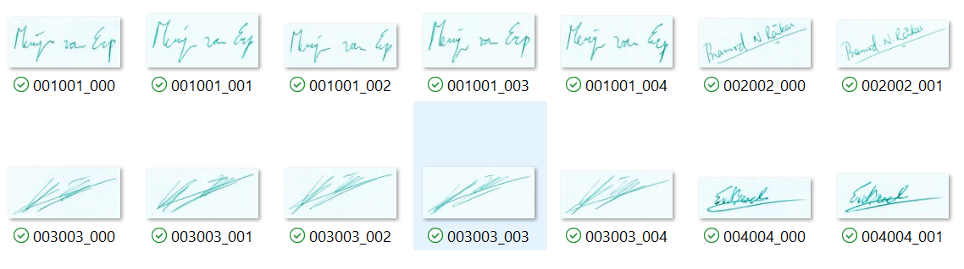
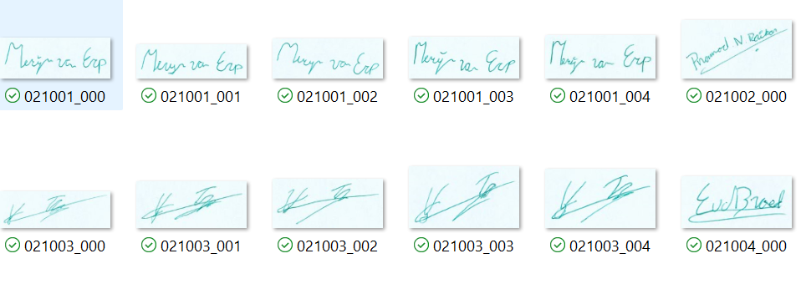
DATA:- Collected various real and forged signatures from different sources , properly processed and organized.
Real signatures :
Forged signatures:

Slide 10
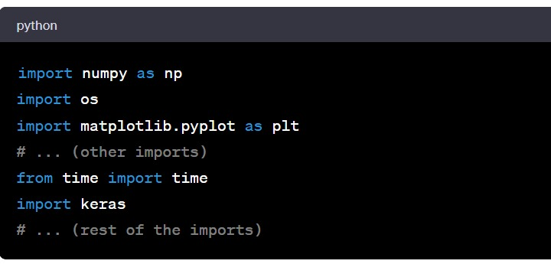
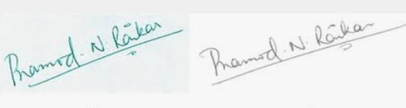
Methodology:-
1.Importing the Libraries:
2.Preprocessing the images:
i. Converting RGB signature images to greyscale images

Slide 11
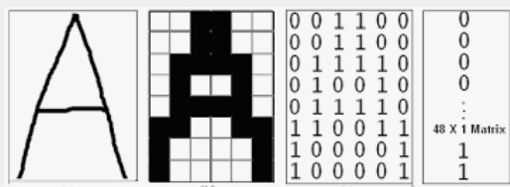
ii . Then , the grey scale image is converted to a binary image using ‘greybin’ involving Guassian filtering to reduce noise and Otsu’s thresholding to determine optimal threshold for binary conversion.
iii . Bounding Box and Cropping : The coordinates of white pixels in the binary image and creates a bounding box around them. Then, it extracts a cropped image only containing signature part.

Slide 12
3.Feature Extraction :
i. With the Ratio() function we calculate the ratio of white pixels to total number of pixels in a binary image.
ii . The Centroid() function calculates the centroid (center of mass) of white pixels in a binary image and returns the coordinates as a tuple.
iii. Then , the regionprops() function analyzes the connected components in a binary image and returns a list of eccentricity and solidity.
iv. The function SkewKurtosis() calculates the skewness and kurtosis along the x and y axes of a given binary image , returns skewx , skewy are the skewness values and kurtx , kurty are the kurtoisis values.

Slide 13
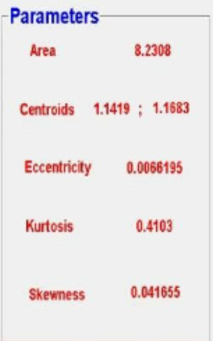
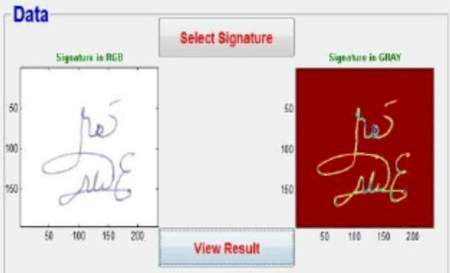
4. CSV file creation :
Saving the features of the signatures with respective to the person in a CSV file that is used as reference for further verification of signatures.

Slide 14
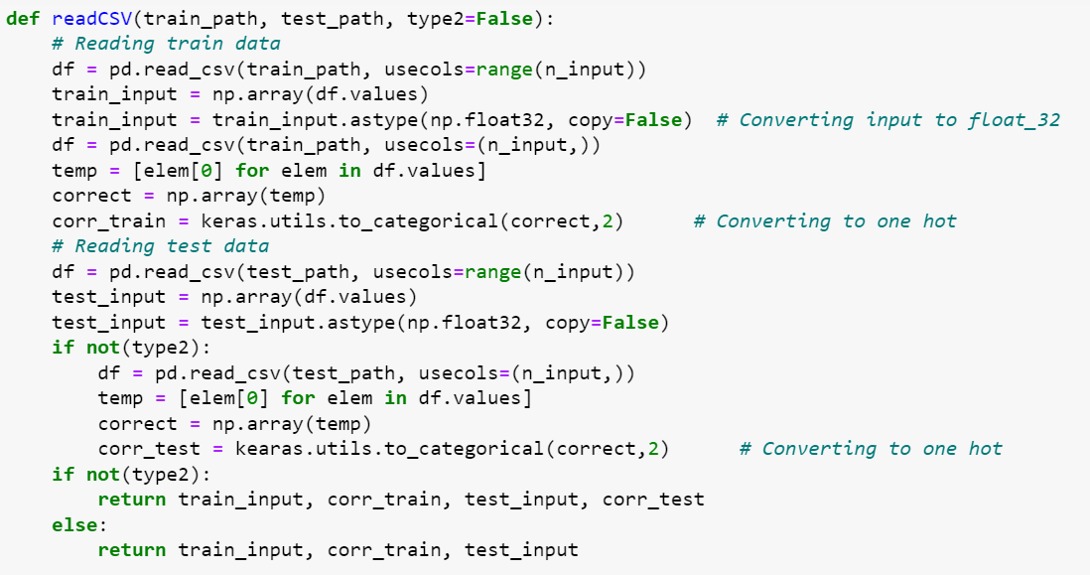
5 . Neural Network implementation :
i. Loading and reading CSV data :
ii. Neural Network Architecture :
It is defined with three hidden layers using the ‘Multilayer Perceptron’ function.

Slide 15
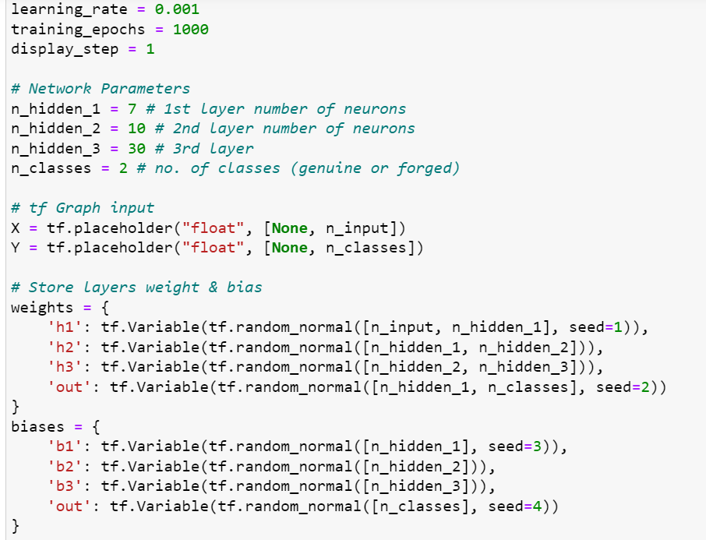
It uses the tanh activation function for the hidden layers and softmax for the output layer.
The weights and bias are randomly initialized.

Slide 16
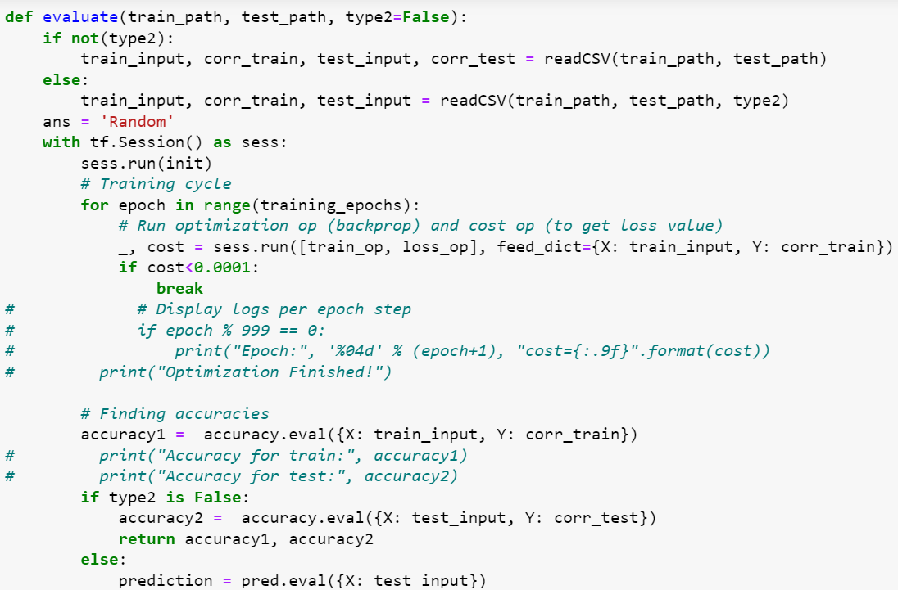
iii. Training the network :
The network is trained using Adam optimizer and mean squared error as the loss function.
6. Evaluation:

Slide 17
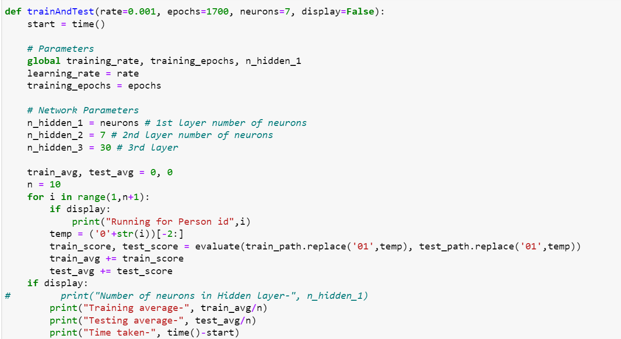
7. Testing :
The train and test loop runs the training and testing processes for multiple iterations.

Slide 18
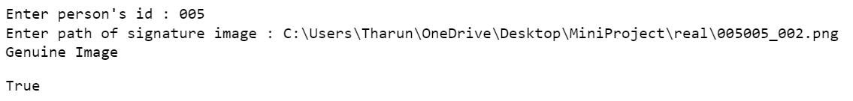
8. Execution :
Finally, the model evaluates using the provided signature image and prints whether it is genuine or forged.

Slide 19
THANK YOU

